Slide 1


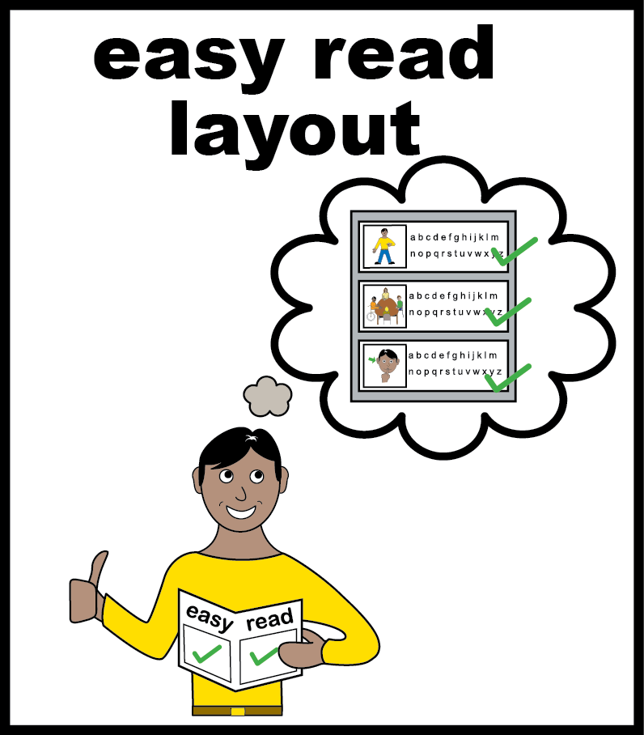

Learning Disability Improvement Standards (Round 5)
Easy Read Report

Slide 2
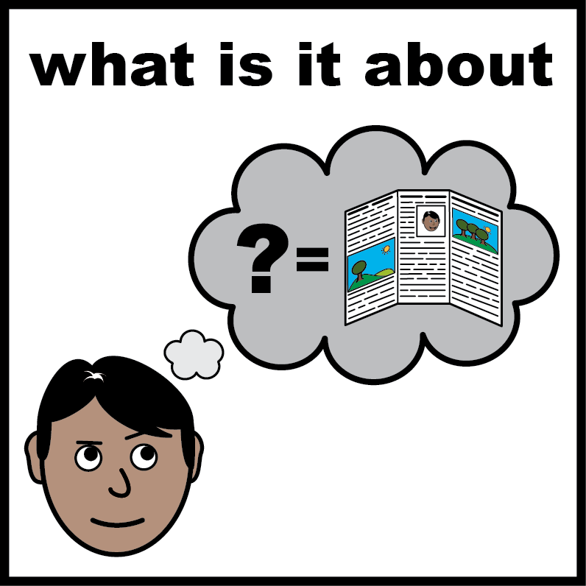
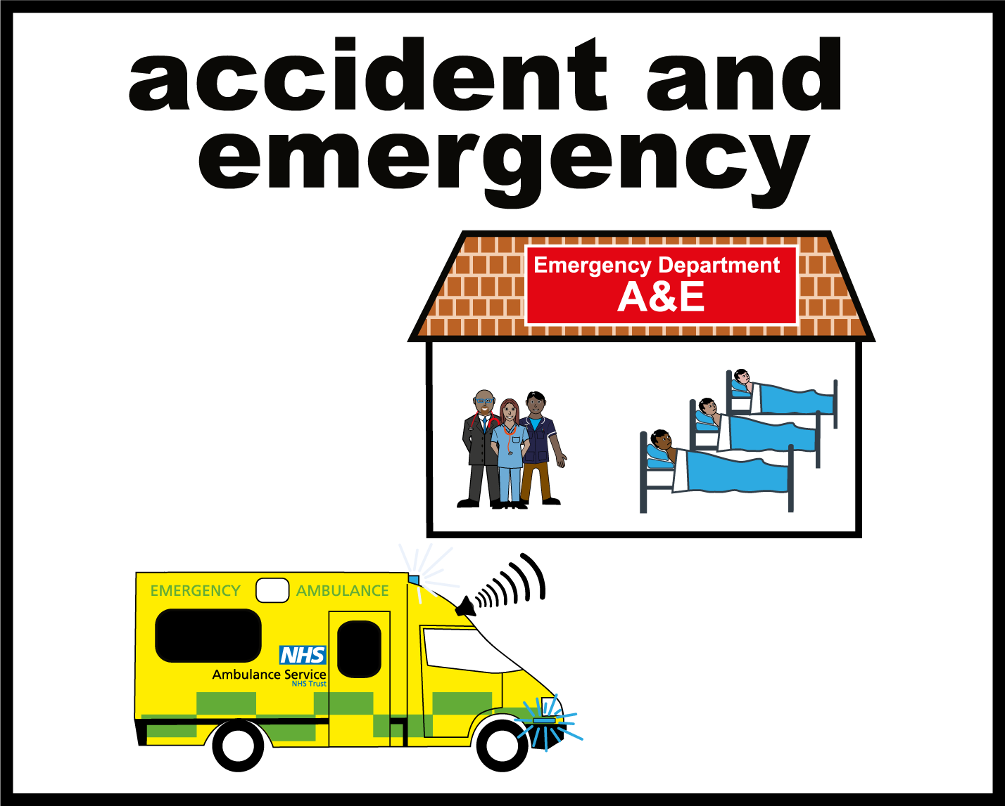
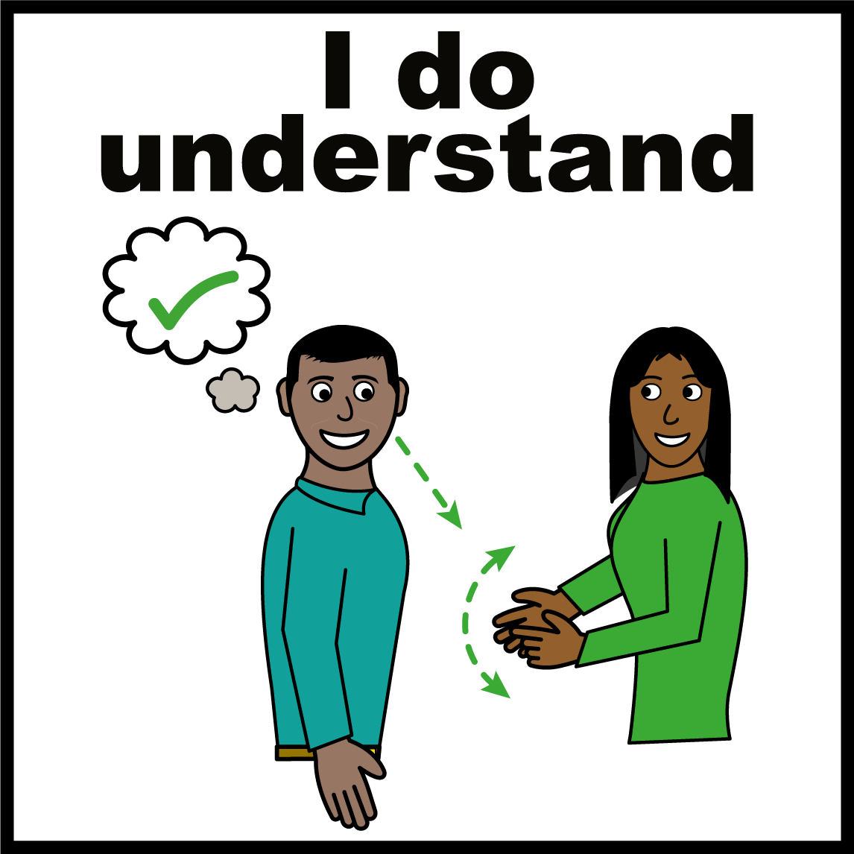
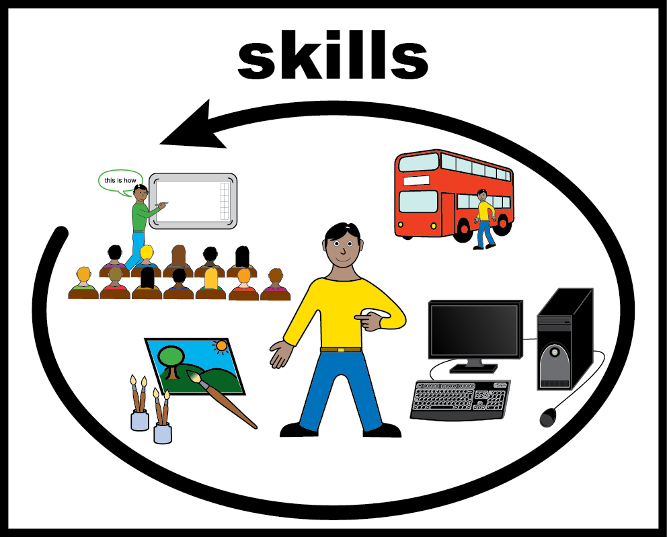
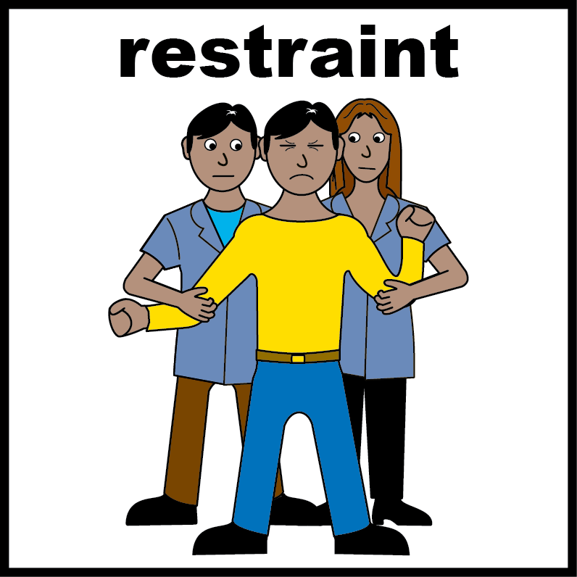
Contents
Page
 | Information | 3
 | Getting help quickly and being treated well | 5
 | Being listened to and having a say in your care | 7
 | Staff being trained to do their job well | 10
 | Keeping people safe and reducing restraint | 11

Slide 3

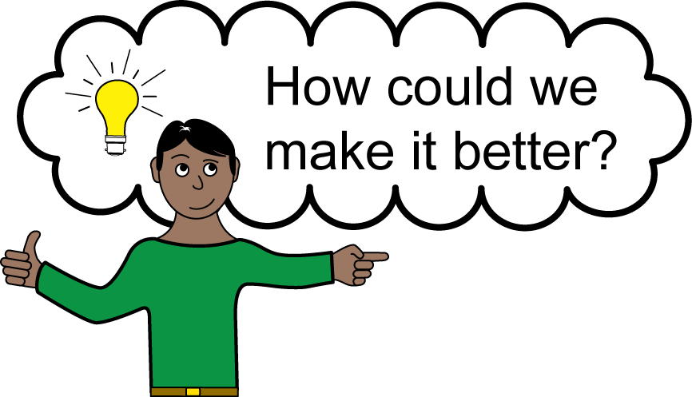
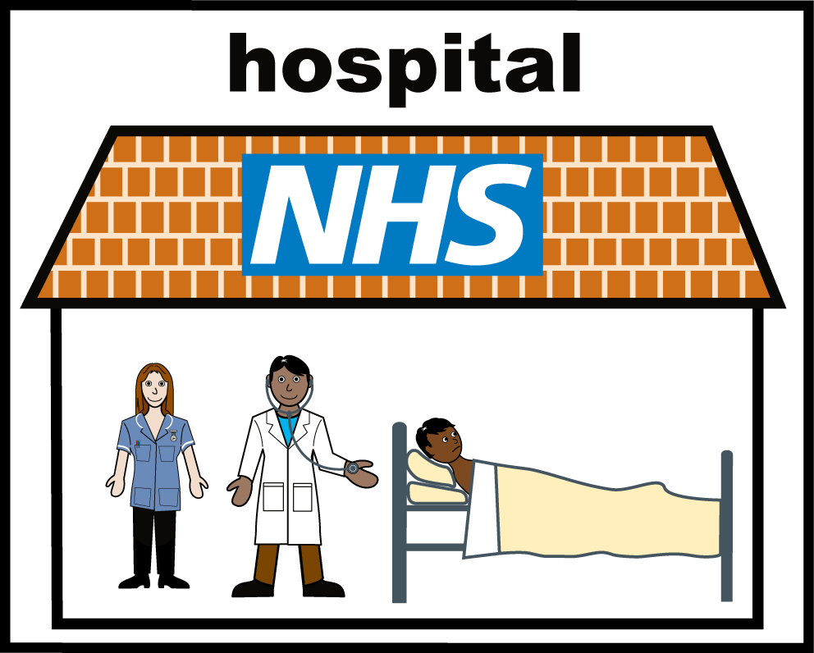
About the Standards
NHS England worked with people who use health services, their families, and NHS staff.
Together they created 4 standards. Standards help measure how good a service is.
They help the NHS improve the care it gives to people.
NHS Benchmarking Network asked NHS trusts in England if they are meeting the 4 standards.
What does “NHS Benchmarking Network" mean?
The NHS Benchmarking Network (NHSBN) helps hospitals and care services learn from information so they can improve.
3

Slide 4
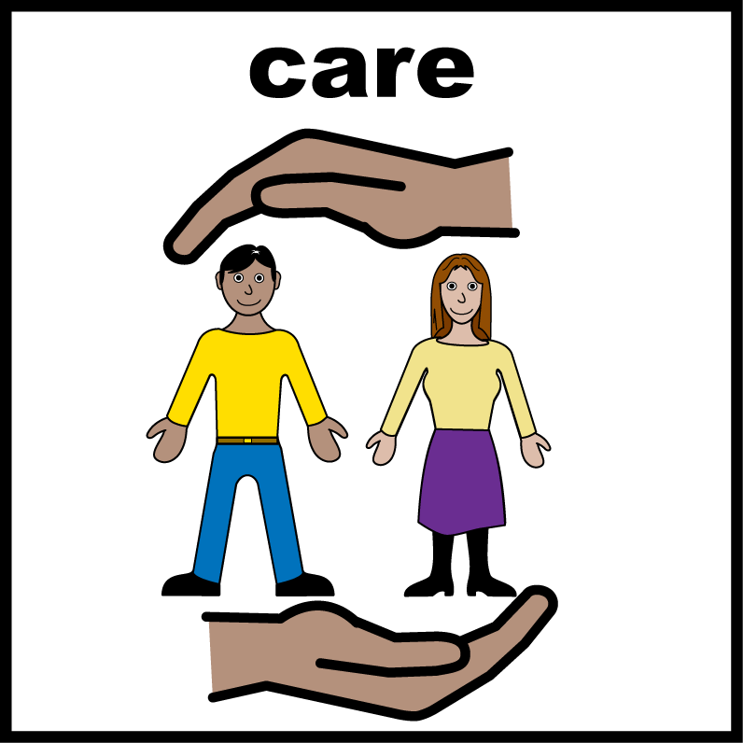
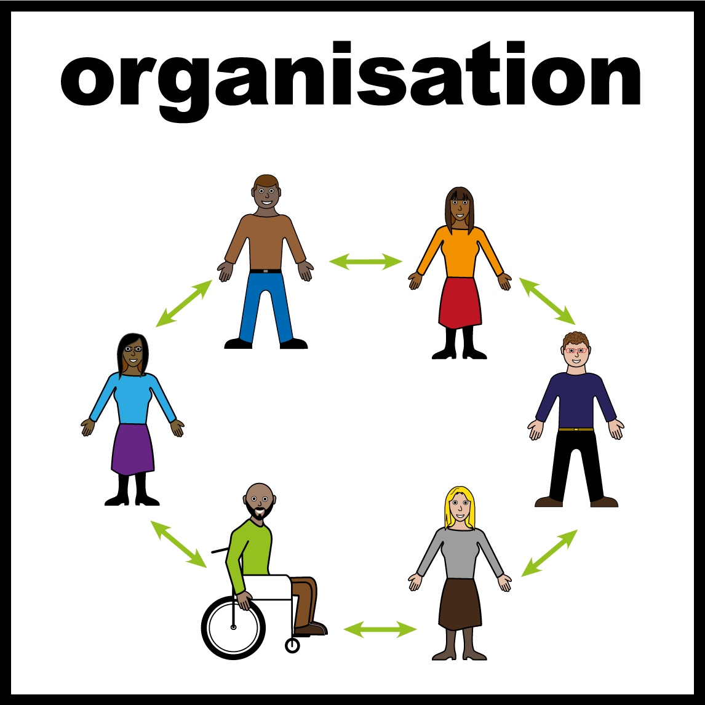
About the Standards
They asked people with a learning disability, autistic people, and their families about the care they had in hospital.
What does “NHS Trust" mean?
An NHS Trust runs hospitals and health services in an area.
A Trust is not a building. It is the organisation in charge.
One Trust can run more than one hospital.
When this report says “Trust“, it means the organisation, not the hospital building.
4

Slide 5
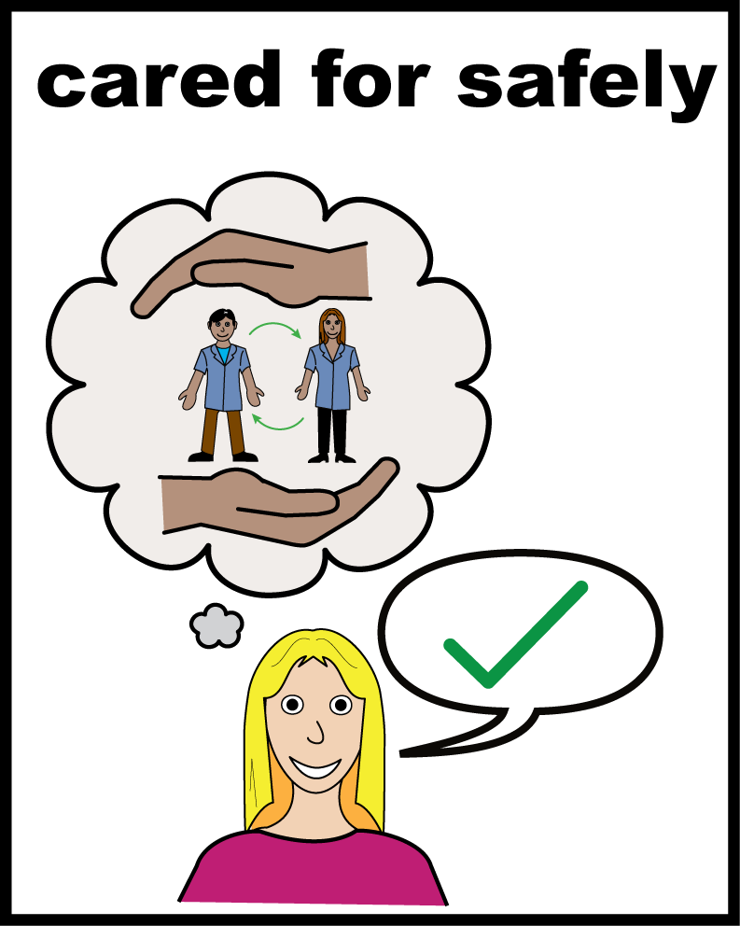
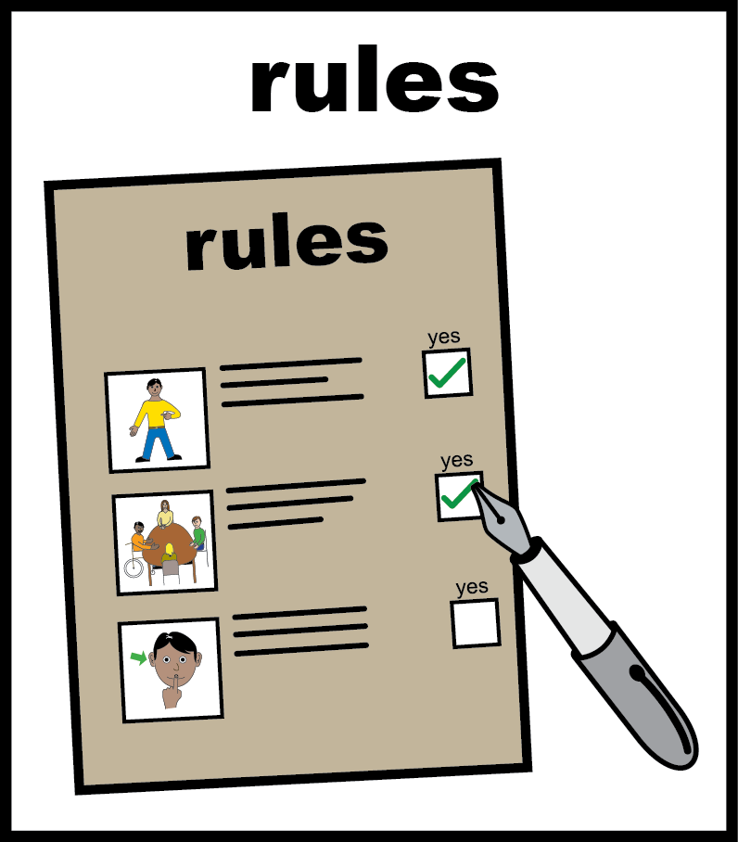
Getting help quickly and being treated well
9 out of 10 people said they felt safe when they got care from the trust.
9 out of 10 trusts had rules about restraint. The rules were for children, young people, adults with a learning disability and autistic people
What does “restraint" mean?
Restraint is when staff stop a person from moving or doing what they want. This can mean holding a person, giving them medicine to calm them down, or stopping them from leaving a room.

Slide 6


Getting help quickly and being treated well
9 out of 10 patients said staff treated them with respect.
8 out of 10 people would recommend the trust to a friend or family member.

Slide 7
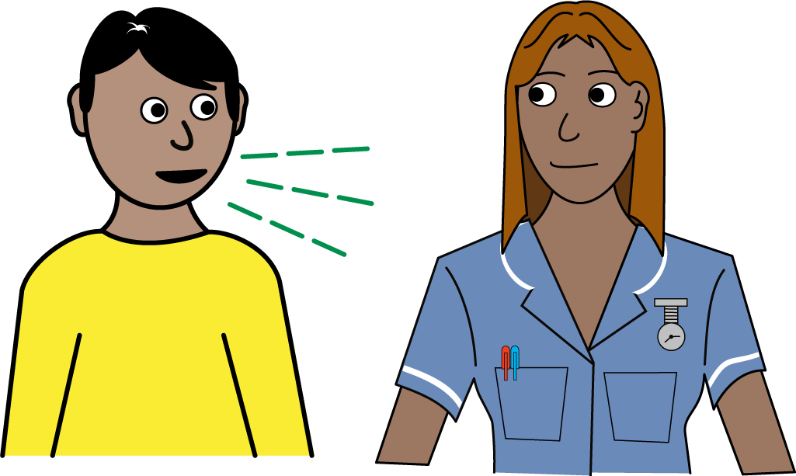
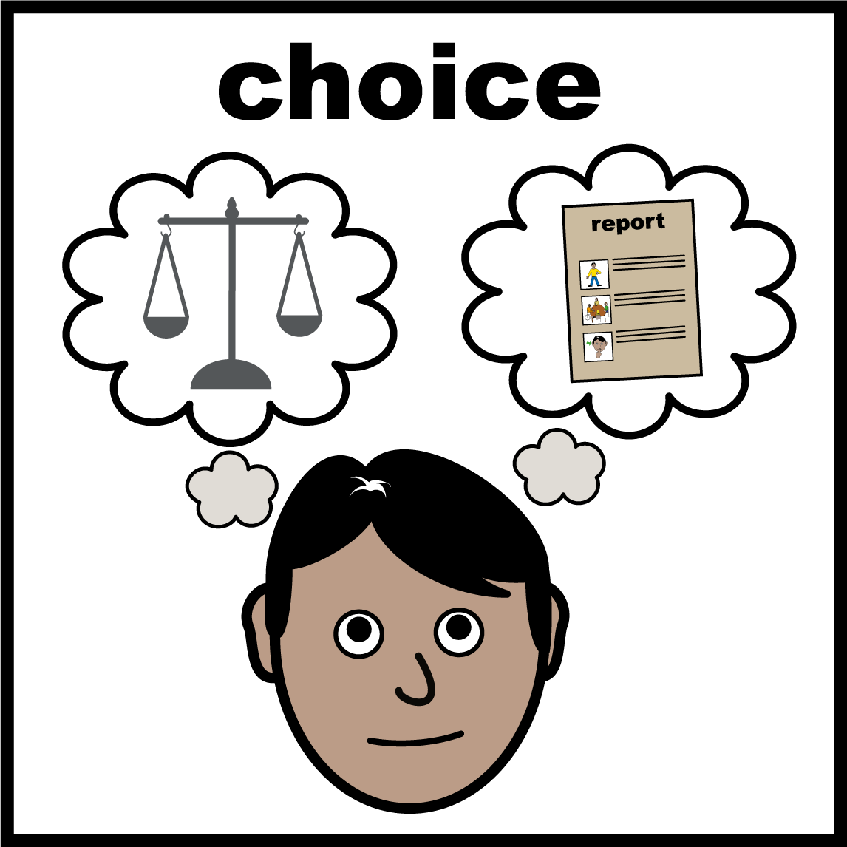
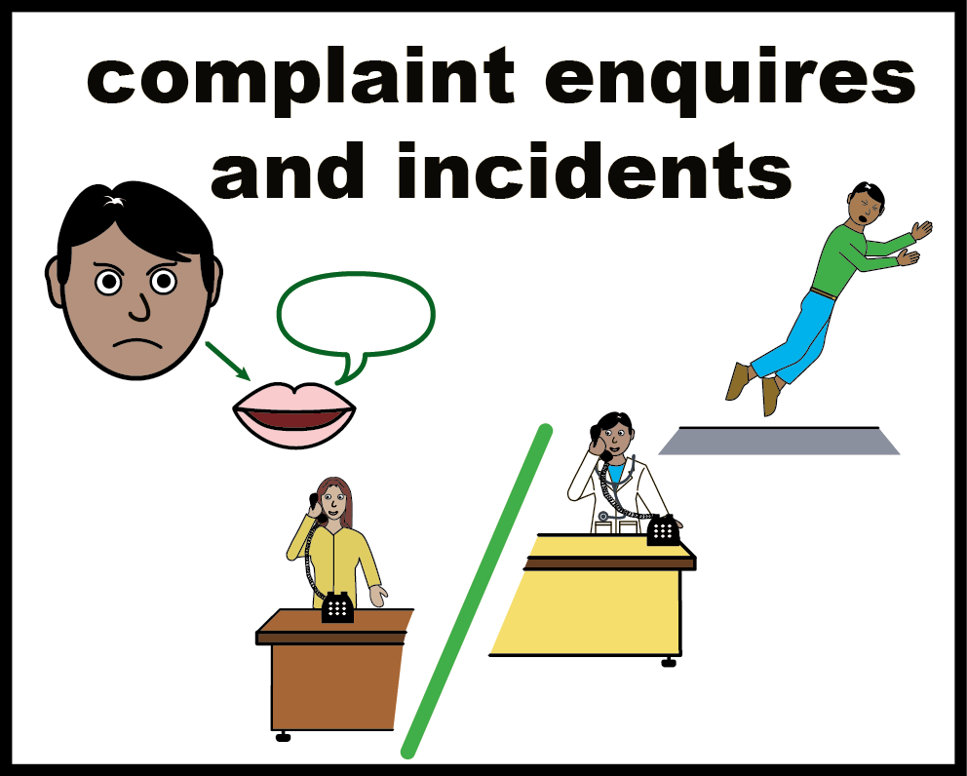

Being listened to and having a say in your care
4 out 5 people said staff listened to their family.
Most staff said they include people with a learning disability and autistic people in decisions about their care.
Most trusts said they make changes to help people complain. This can mean fewer forms to fill in.
3 out of 5 people who wanted to complain said they were not given easy read information about how to complain.

Slide 8
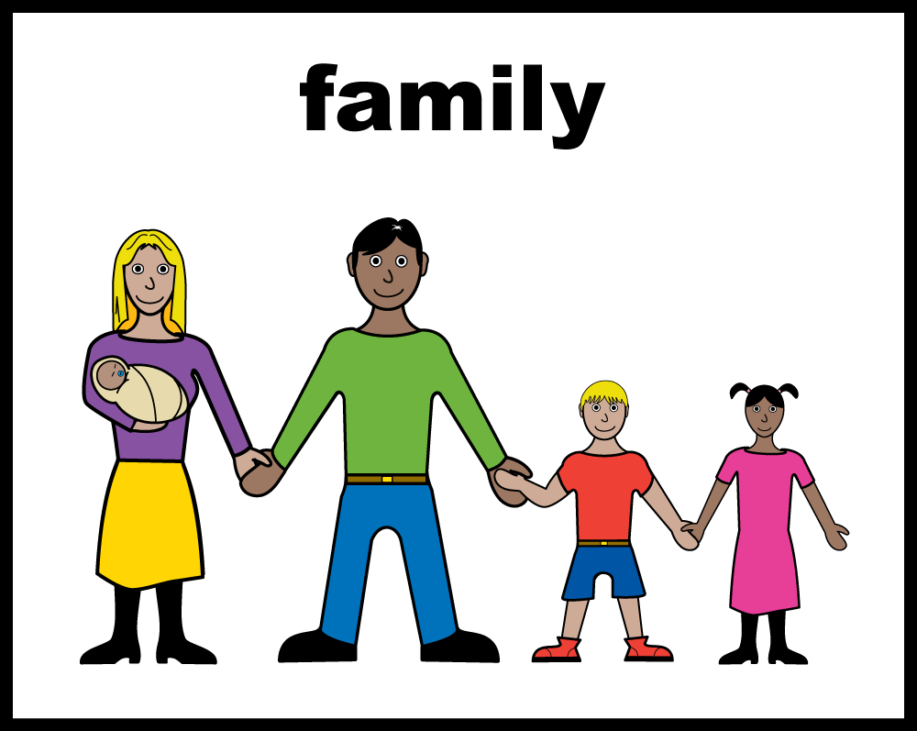

Being listened to and having a say in your care
Almost all acute hospital trusts said family carers could stay overnight.
1 out of 3 staff did not agree that their trust had rules to protect autistic people's rights.
What does “acute hospital trust" mean?
Hospitals that treat physical health problems.

Slide 9
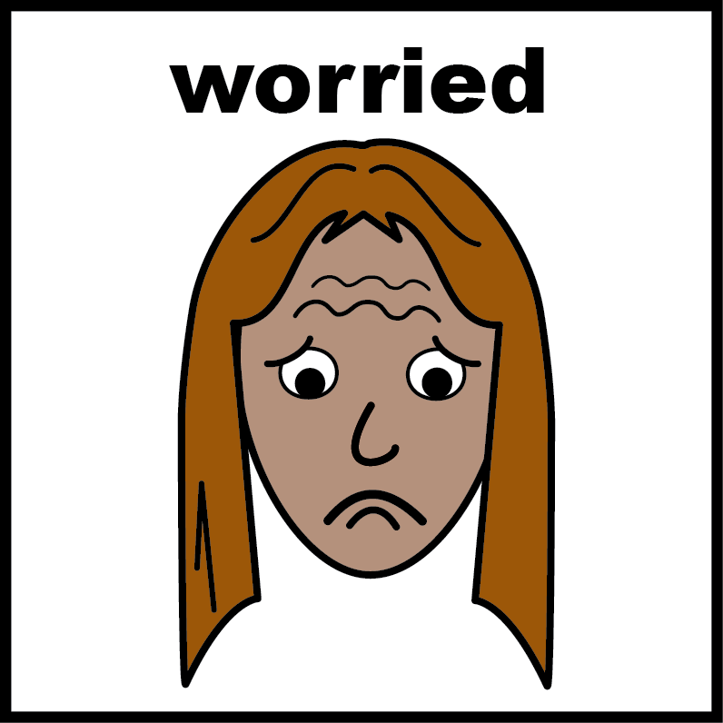
Being listened to and having a say in your care
2 out of 5 trusts said they did not use Ask, Listen, Do resources. These resources help trusts improve after feedback, worries and complaints.
What does "Ask, Listen, Do" mean?
It is a set of rules that helps the NHS make it easier for people with a learning disability and autistic people to give feedback, raise concerns, and make complaints.

Slide 10
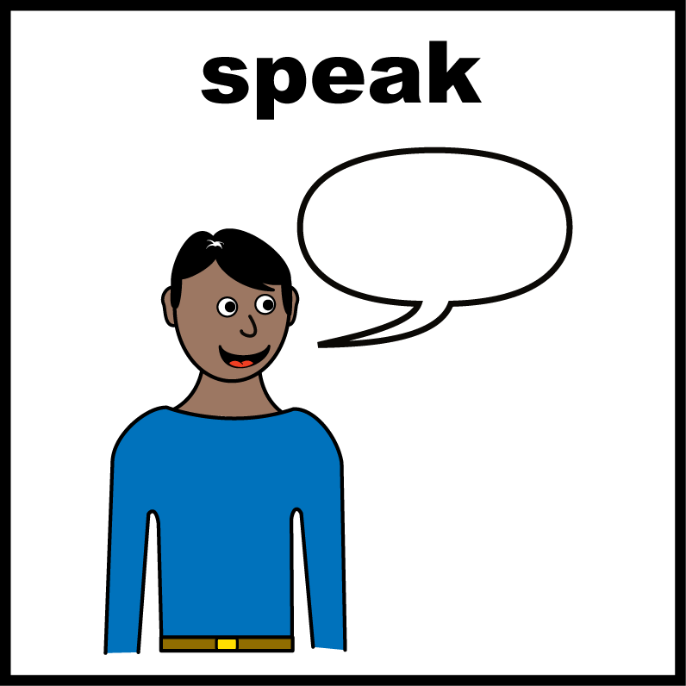
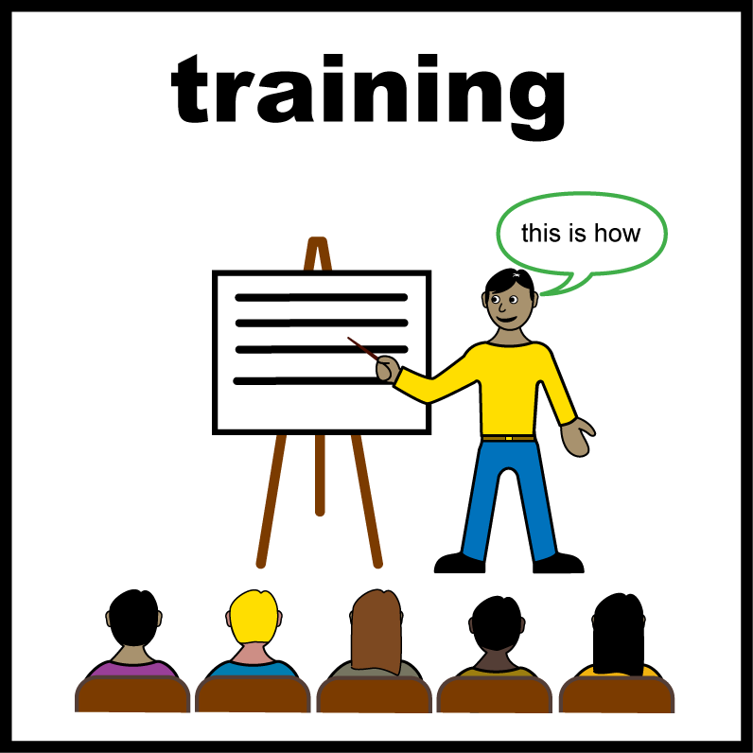
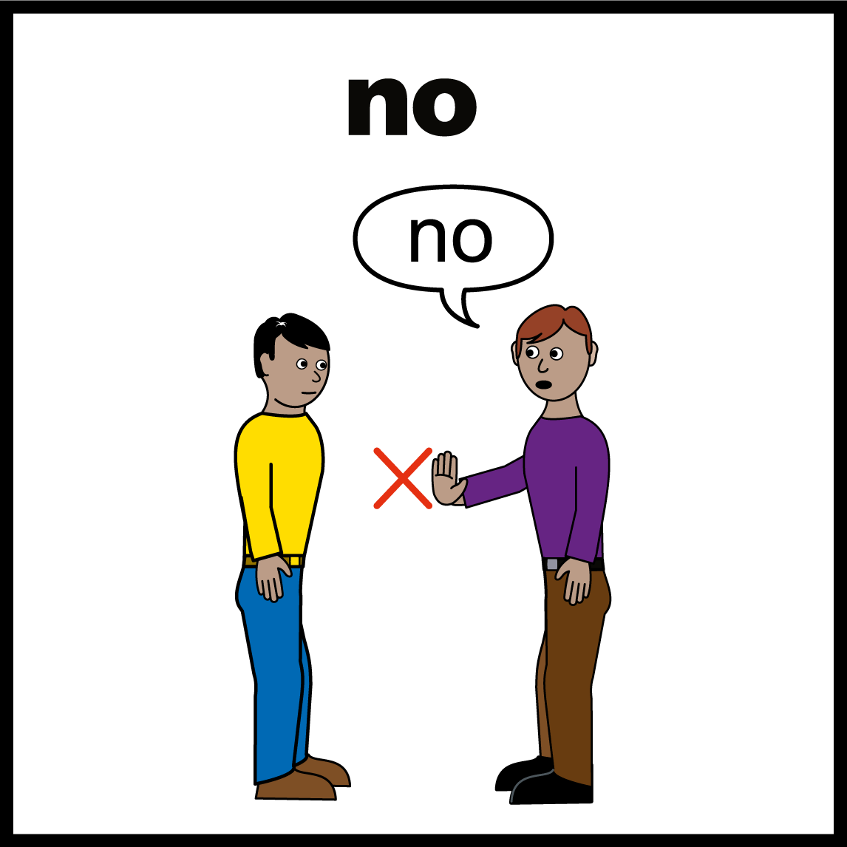
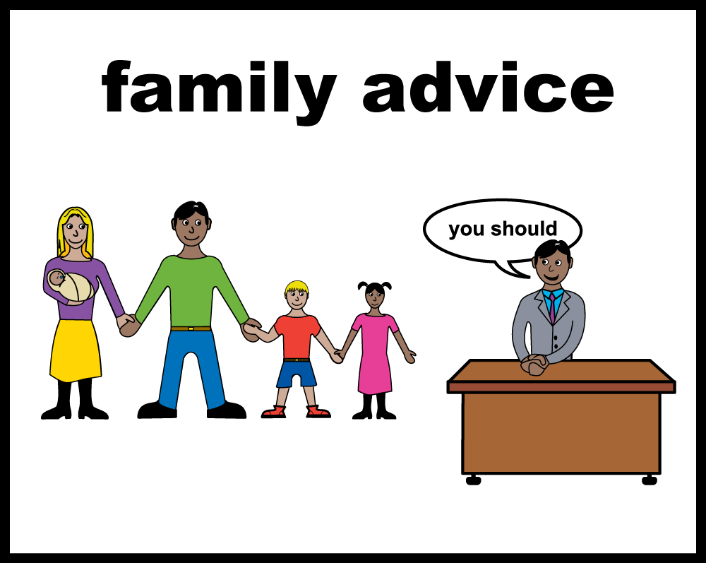
Staff being trained to do their job well
4 out of 5 staff said they could get help from staff who know a lot about learning disability, when they needed it.
9 out 10 trusts said staff get up-to-date training about learning disabilities and autism.
1 out of 3 staff said they did not get the training they needed to support people with a learning disability or autistic people.
Over half of hospitals involved people with a learning disability or autistic people, and their families, in checking and improving services.

Slide 11
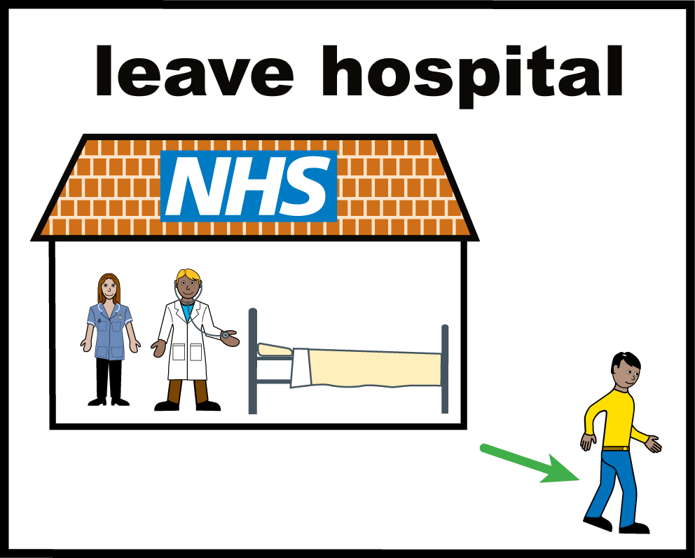
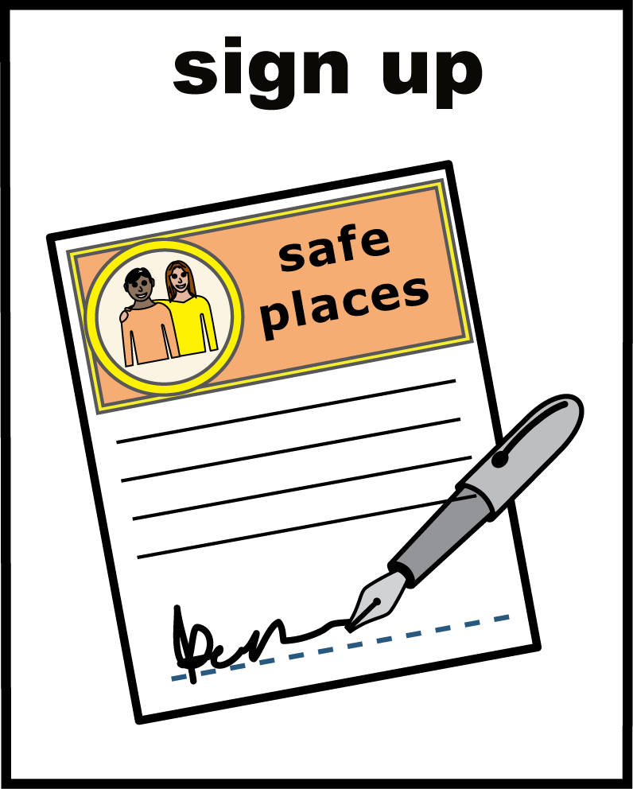
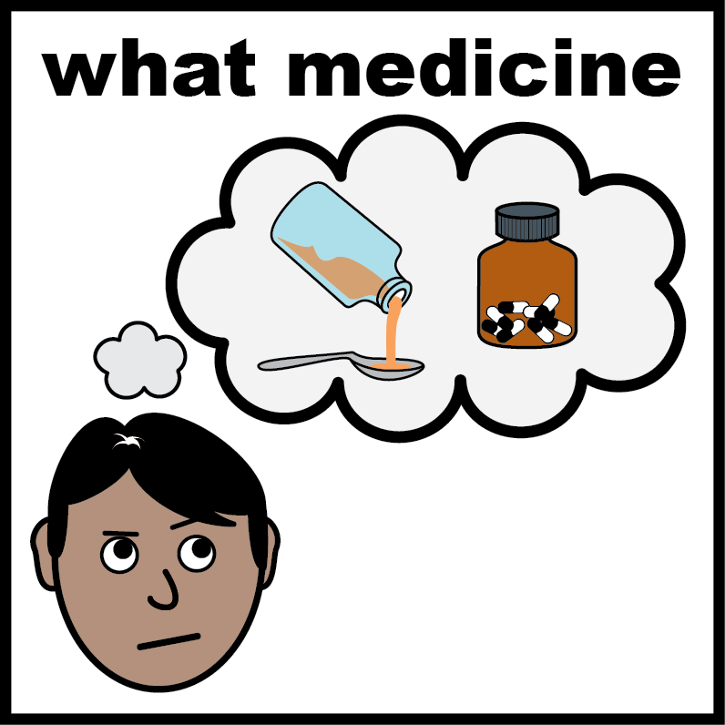

Keeping people safe and reducing restraint
4 out of 5 trusts checked when people with a learning disability or autistic people were meant to leave hospital, and when they really left.
9 out of 10 trusts signed the STOMP pledge.
Half of staff said this: people with a learning disability and autistic people helped to check that their mental health medicines were working well for them.
What is the “STOMP pledge“?
The STOMP pledge is a promise to stop giving too much medicine to people with a learning disability or autistic people.

Slide 12
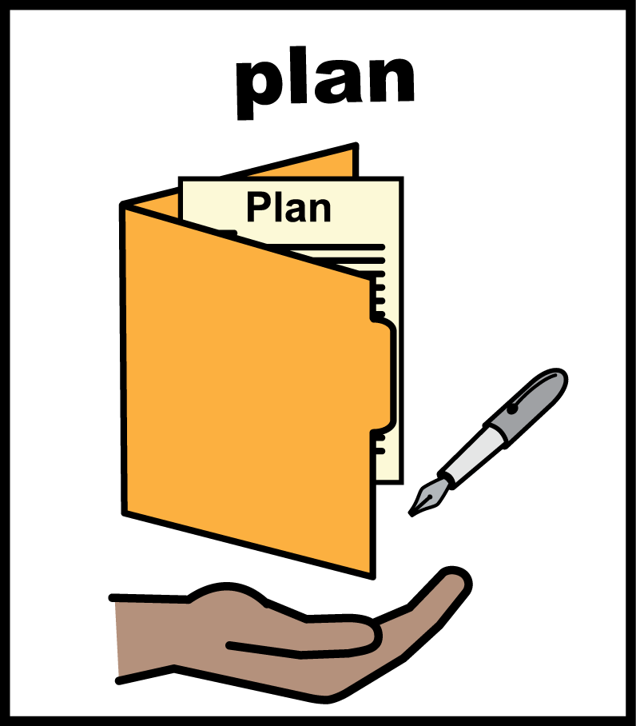
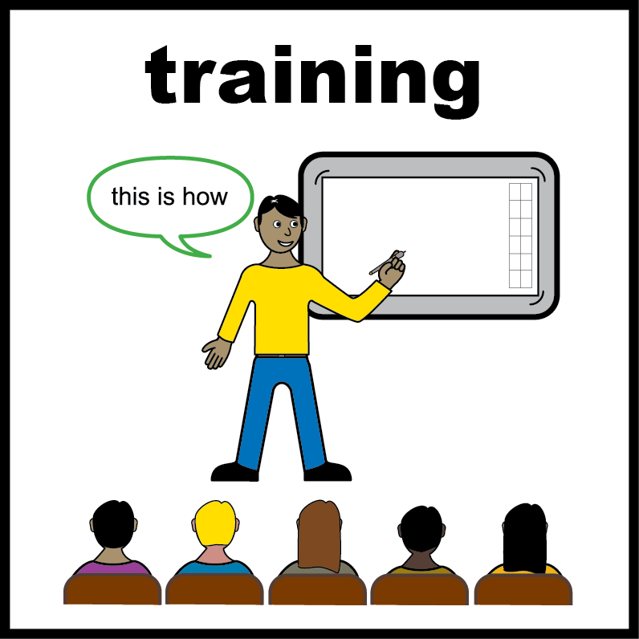
Keeping people safe and reducing restraint
9 out of 10 trusts said they had a plan or policy to use less restraint.
3 out of 5 staff said they had training on how to restrain people less, and other ways to keep people safe.
What does “restraint" mean?
Restraint is when staff stop a person from moving or doing what they want. This can mean holding a person, giving them medicine to calm them down, or stopping them from leaving a room.

Slide 13
www.nhsbenchmarking.nhs.uk
Find out more:

